Slide 1
What factors lead to employee attrition in a company?
Machhindra Basnet
Thinkful Data Science Bootcamp

Slide 2
Introduction and Objectives
I have used IBM HR Analytics Employee Attrition & Performance dataset from Kaggle which is a fictional data set created by IBM data scientists.
https://www.kaggle.com/pavansubhasht/ibm-hr-analytics-attrition-dataset
The aim is to explore the dataset, understand the algorithms and techniques which can be applied on it and fit the models using appropriate machine learning algorithms
Choose the best model that accurately level Employee attrition

Slide 3
Why we care about Employee Attrition?
The major problem that every company face irrespective of the work sector is the Employee Attrition. Proper strategies and ideas are required to control the growing employee attrition rate
Create an accurate classifier that will help to reduced the attrition identifying the major factors responsible for attrition

Slide 4
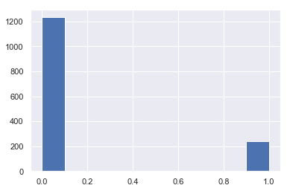
Data Exploration
The dataset consists of 1470 observations and 35 features; out of which 9 features are categorical
16% of the dataset constitutes out target variable, showing quite a large skew in the target

Slide 5
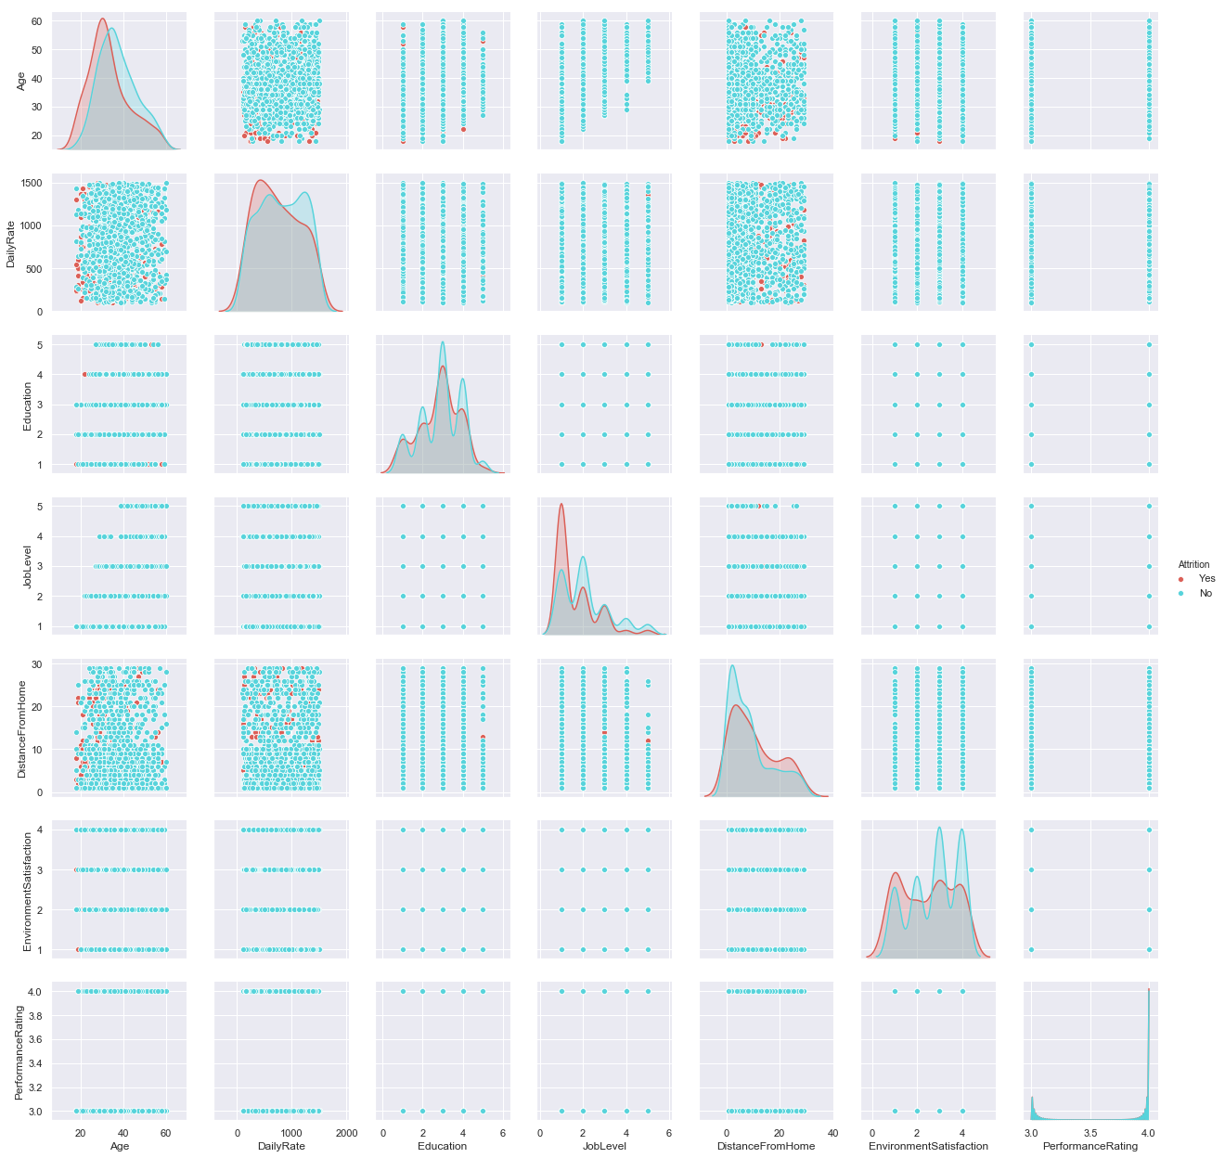
Created a pair plot to see the distribution and relationship between the variables
Employees in the lower age group are more likely to have attrition.
Employees living < 20 minutes distance from the home have higher attrition
Employees with lower level of environmental satisfaction seems to have higher attrition
Employees with job level less than 4 seems to have higher attrition

Slide 6
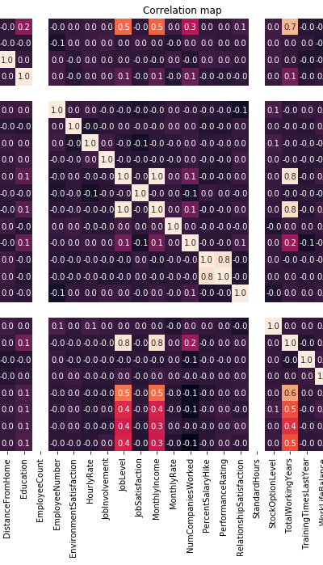
Created a heatmap to check multicollinearity
The correlation matrix shows the statistical relationship between the features
The performance of the model can deteriorate if two variables higher correlated with each other (multicollinearity)
Most of the features are unrelated to each other
Shows strong correlation among the features 'PercentSalaryHike' and 'Performance rating’, 'TotalWorking’ and 'Joblevel' and 'MonthlyIncome'

Slide 7
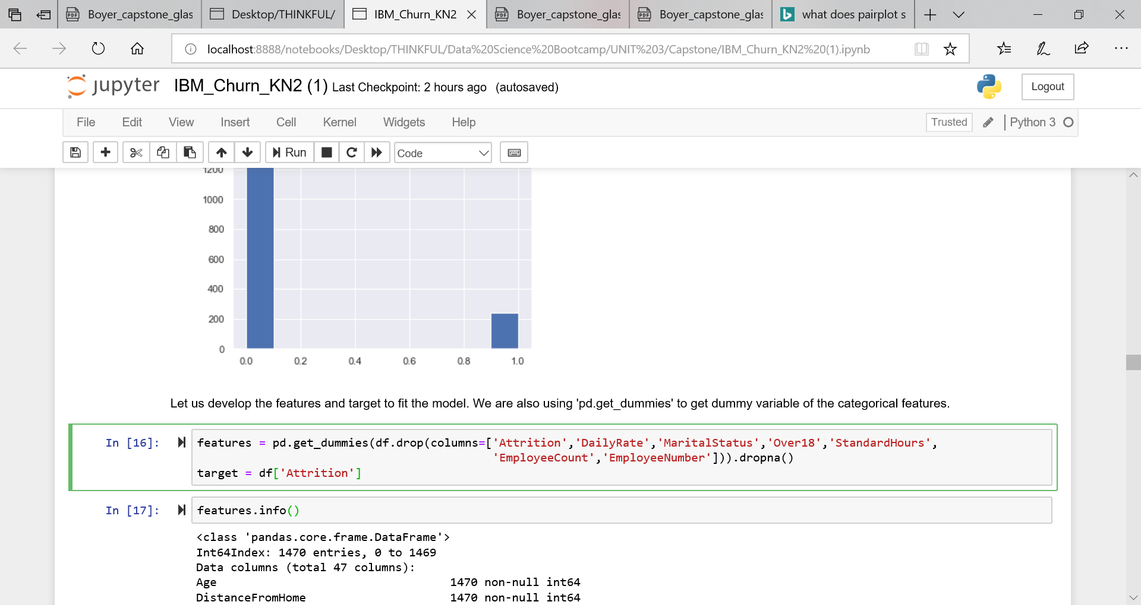
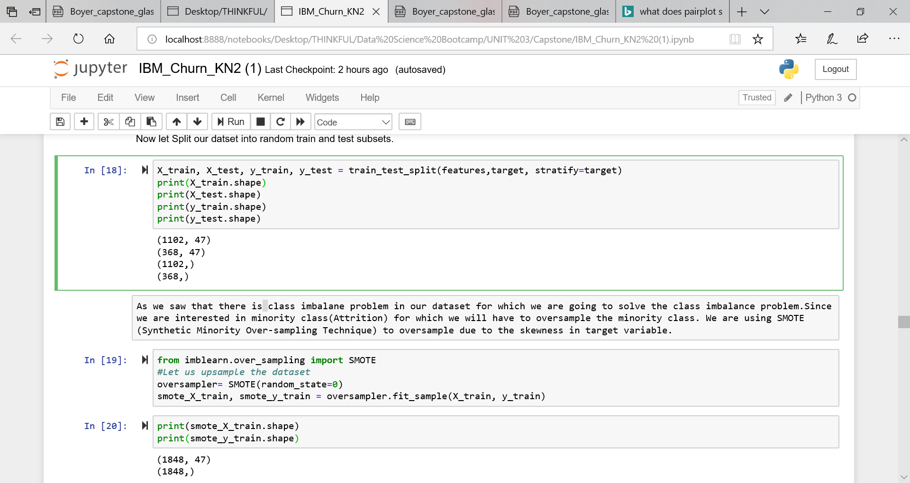
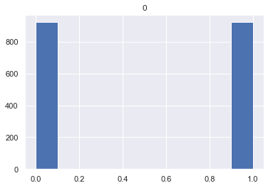
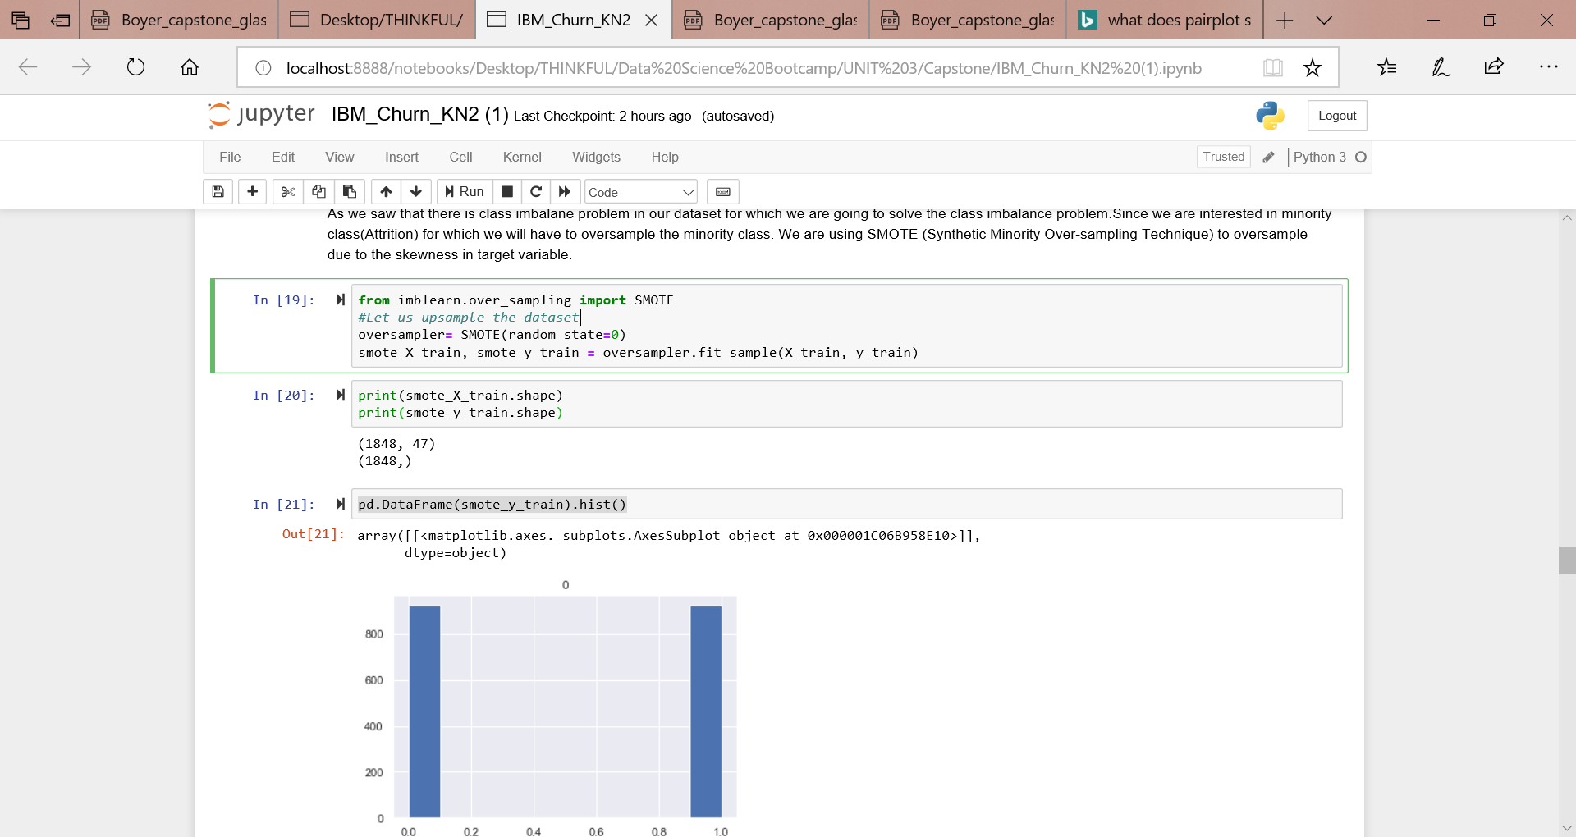
Feature selection and data split to train and test sets
Dropped some features that were found not having any relation with target during data exploration
Got dummies for the categorical features for modeling
Spitted the dataset to random train and test subsets and stratified on y
Oversampled the minority class using SMOTE (Synthetic Minority Over-sampling Technique) to oversample due to the skewness in target variable.

Slide 8
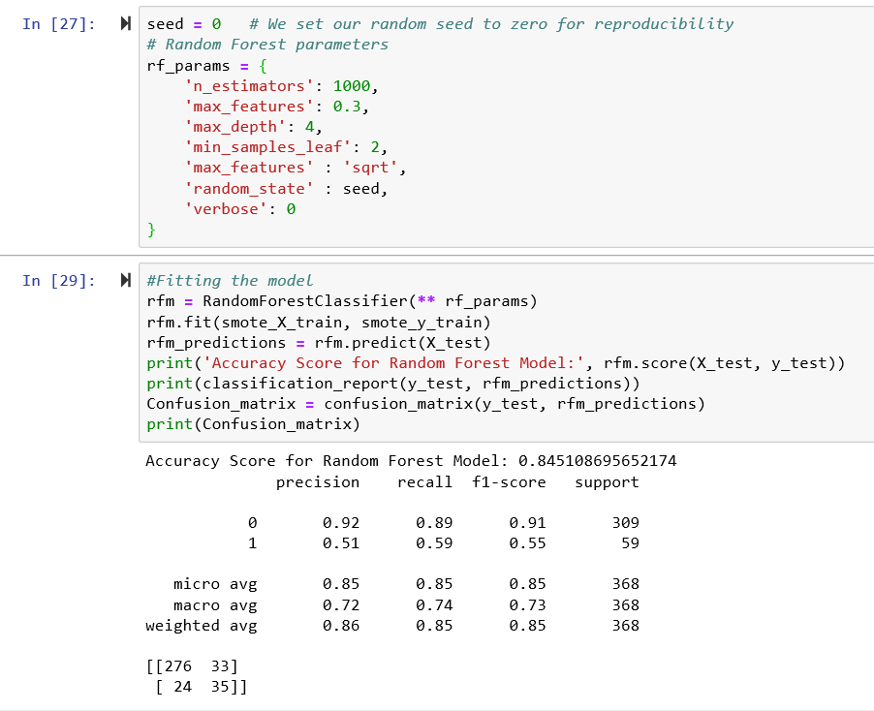
Random Forest Classifier
Accuracy of the model : 85% (approx.)
Precision (TP/TP+FP): 51% ;
# Ability of the classifier not to label as attrition when the sample is attrition
Recall (TP/TP+FN): 59%
# Ability to find all positive attrition
Our intention is to get lower False Negative result(Type II error; which indicates a samples in non attrition class when in fact its Attrition)
Random forest classifier identifies 24 samples as False Negative

Slide 9
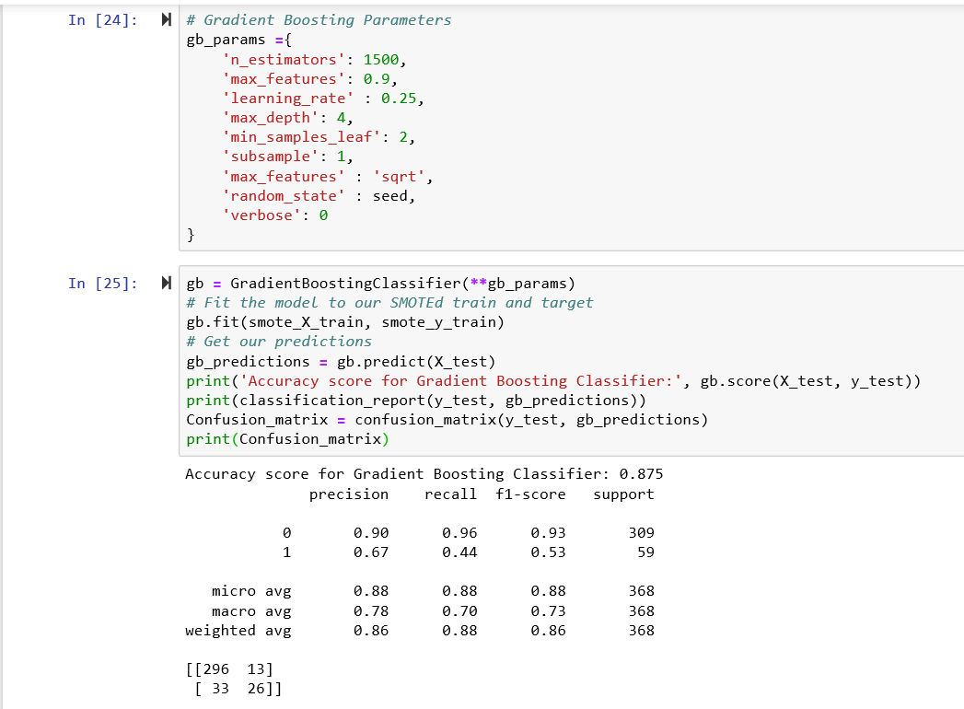
Gradient Boosting Classifier
Accuracy of the model : 87%
Precision (TP/TP+FP): 67% ;
Recall (TP/TP+FN): 44%
Gradient Boosting Classifier identifies 33 samples as False Negative

Slide 10
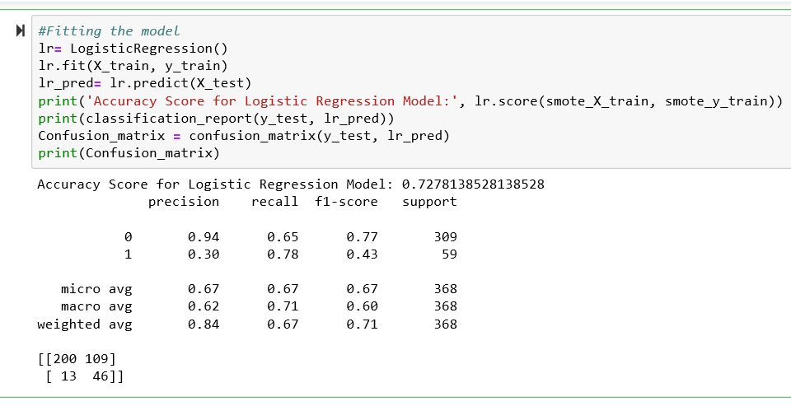
Logistic Regression
Accuracy of the model : 73% (approx.)
Precision (TP/TP+FP): 30% ;
Recall (TP/TP+FN): 78%
Logistic Regression identifies 13 samples as False Negative

Slide 11
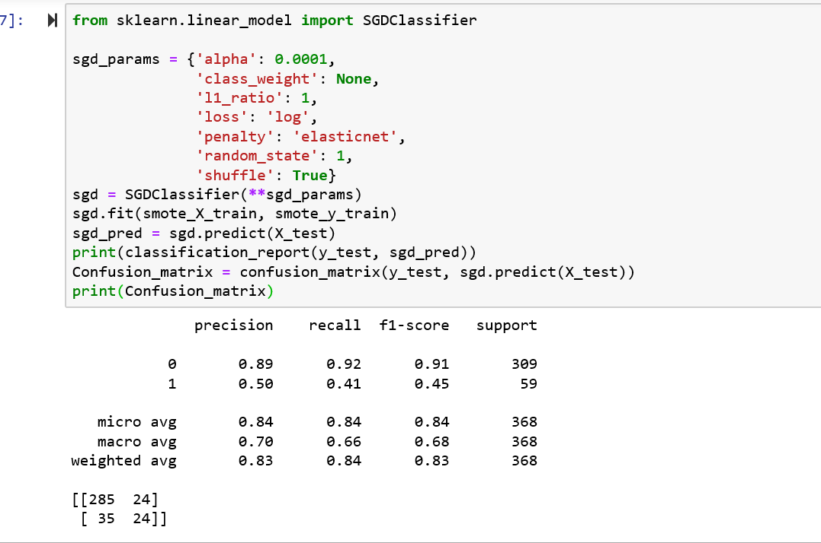
Stochastic Gradient Descent (SGD) Classifier
Accuracy of the model : 84% (approx.)
SGD classifier identifies 27 samples as False Negative
SGD Classifier identifies 35 samples as False Negative

Slide 12
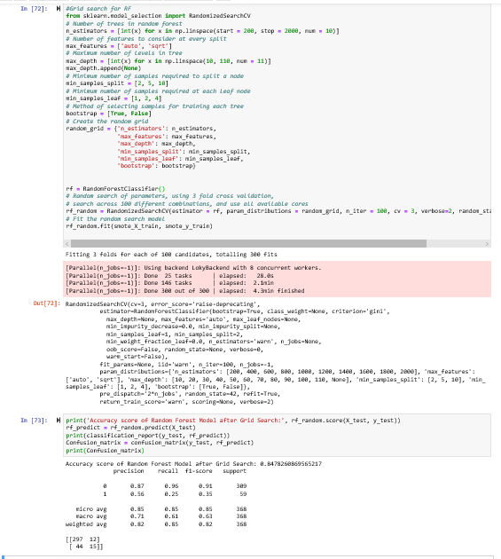
Fitting the model after Grid Search on winning Random Forest Model
Accuracy of the model : 85% (approx.)
Precision (TP/TP+FP): 56% ;
Recall (TP/TP+FN): 25%
Random forest with best parameter identifies 44 samples as False Negative

Slide 13
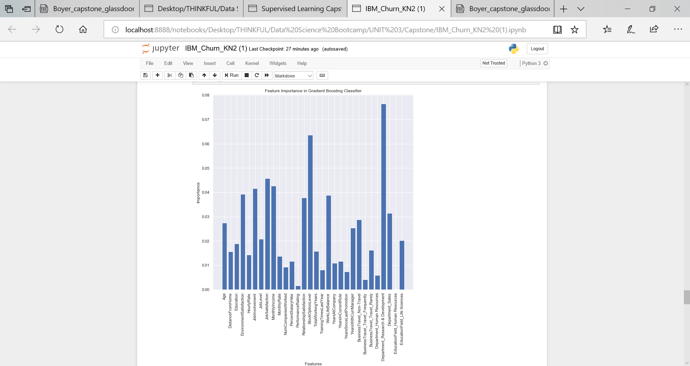
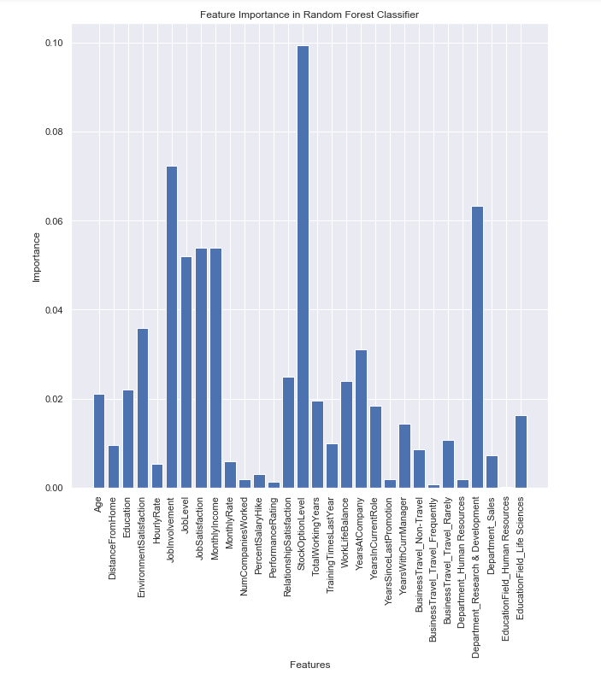
Feature Importance
Feature importance attribute from Random Forest and Gradient Boosting Classifier recognizes similar features as the ones contributing to employee attrition.
The major predictors for attrition are;
StockOptionLevel
JobInvolvement
JobSatisfaction..

Slide 14
Conclusion
Identified a simple pipeline of predicting employee attrition from basic Exploratory Data Analysis, feature engineering and implementing four models;
Random Forest Classifier,
Gradient Boosting Classifier,
Logistic Regression and
SGD classifier.
Fitting the model with best parameters during grid search in our winning model (Random Forest) didn’t give better result
Random forest is winning model with best type 2 error even though overall accuracy (85%) is slightly lower than gradient boosting (87%)

Slide 15
Next Steps
Productionize this, with more data I want to fit a NN

Slide 16
Questions???

